Slide 1

DHCPv4 & NAT
Lecture 11 | Part 1 | CSE490 – WAN Routing
Department of Computer Science and Engineering School of Data & Science

Slide 2
Objectives
DHCPv4
Configure a Cisco IOS DHCPv4 Server
Configure a DHCPv4 Client
NAT Concepts
Introduction to NAT
PAT (NAT Overloading)
Port Forwarding

Slide 3
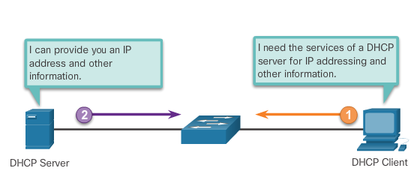
DHCPv4 Concepts

Slide 4
Why DHCP?
Every device that connects to a network needs an IP address.
Network administrators assign static IP addresses to routers, servers, and other network devices whose locations (physical and logical) are not likely to change.
User computers in an organization often change locations, physically and logically.
Mobile/Moving clients do not require a static address.
A workstation can use any address within a range of addresses.
This range is typically within an IP subnet.

Slide 5
DHCP Operations
Dynamic Host Configuration Protocol v4 (DHCPv4) assigns IPv4 addresses and other network configuration information dynamically.
A dedicated DHCPv4 server is scalable and relatively easy to manage. However, in a small branch or SOHO location, a Cisco router can be configured to provide DHCPv4 services without the need for a dedicated server.
The DHCPv4 server dynamically assigns, or leases, an IPv4 address from a pool of addresses for a limited period of time chosen by the server, or until the client no longer needs the address.
Clients lease the information from the server for an administratively defined period. The lease is typically anywhere from few hours to a week or more. When the lease expires, the client must ask for an extension of the lease.

Slide 6
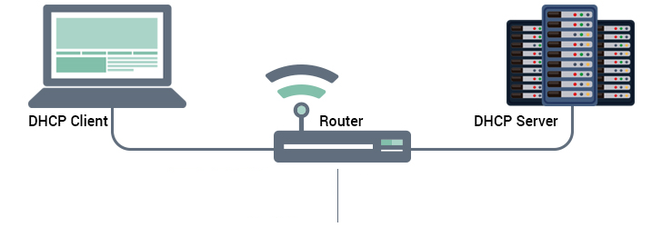

DHCP Operations (Continued)
DHCPv4 works in a client/server mode. When a client communicates with a DHCPv4 server, the server assigns or leases an IPv4 address to that client.
The client connects to the network with that leased IPv4 address until the lease expires. The client must contact the DHCP server periodically to extend the lease.
This lease mechanism ensures that clients that move or power off do not keep addresses that they no longer need.
When a lease expires, the DHCP server returns the address to the pool where it can be reallocated as necessary.
Yes/no
Your lease is extended
I need an IP and etc. info
Here’s everything for a short period of time
Extend my lease
Are you still there?
DHCP IP Pool

Slide 7
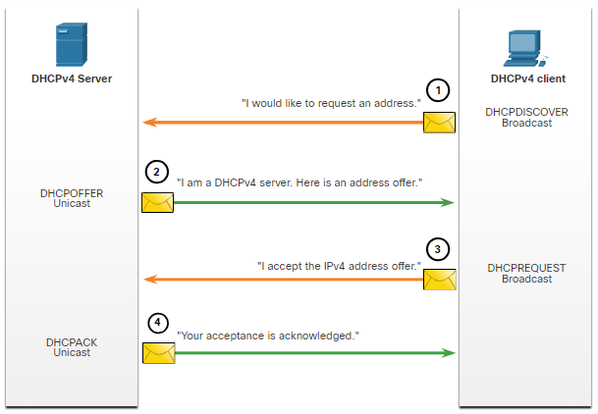
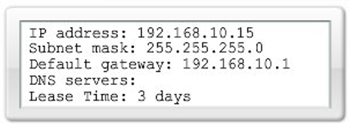
Steps to Obtain a Lease (DORA)
When the client boots (or otherwise wants to join a network), it begins a four-step process to obtain a lease:
DHCP Discover (Broadcast)
Finds the DHCP server(s) on the network.
DHCP Offer (Unicast)
Contains an available IP address to lease
DHCP Request (Broadcast)
It serves as an acceptance notice to the selected server and an implicit decline to any other servers
Also used for lease renewal and verification
DHCP Acknowledgment (Unicast)
Verifies the lease information.

Slide 8
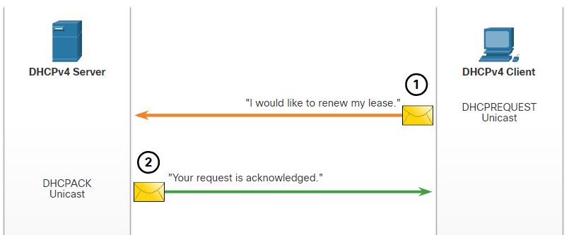
Steps to Renew a Lease
Prior to lease expiration, the client begins a two-step process to renew the lease with the DHCPv4 server, as shown in the figure:
DHCP Request (DHCPREQUEST)
Before the lease expires, the client sends a DHCPREQUEST message directly to the DHCPv4 server that originally offered the IPv4 address. If a DHCPACK is not received within a specified amount of time, the client broadcasts another DHCPREQUEST so that one of the other DHCPv4 servers can extend the lease.
DHCP Acknowledgment (DHCPACK)
On receiving the DHCPREQUEST message, the server verifies the lease information by returning a DHCPACK.
Note: These messages (primarily the DHCPOFFER and DHCPACK) can be sent as unicast or broadcast according to IETF RFC 2131.

Slide 9
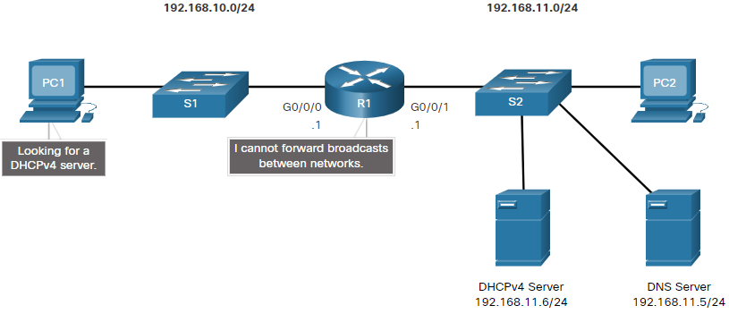
DHCP Relay
In a complex hierarchical network, enterprise servers are usually located centrally. These servers may provide DHCP, DNS, TFTP, and FTP services for the network. Network clients are not typically on the same subnet as those servers. In order to locate the servers and receive services, clients often use broadcast messages.
In the figure, PC1 is attempting to acquire an IPv4 address from a DHCPv4 server using a broadcast message. In this scenario, R1 is not configured as a DHCPv4 server and does not forward the broadcast. Because the DHCPv4 server is located on a different network, PC1 cannot receive an IP address using DHCP. R1 must be configured to relay DHCPv4 messages to the DHCPv4 server.

Slide 10
Other Service Broadcast Relayed
DHCPv4 is not the only service that the router can be configured to relay. By default, the ip helper-address command forwards the following eight UDP services:
Port 37: Time
Port 49: TACACS
Port 53: DNS
Port 67: DHCP/BOOTP server
Port 68: DHCP/BOOTP client
Port 69: TFTP
Port 137: NetBIOS name service
Port 138: NetBIOS datagram service

Slide 11
DHCPv4 & NAT
Lecture 11 | Part 2 | CSE490 – WAN Routing
Department of Computer Science and Engineering School of Data & Science

Slide 12
DHCPv4 Server Configuration

Slide 13
Steps to Configure a CISCO IOS DHCP Server
A Cisco router running Cisco IOS software can be configured to act as a DHCPv4 server. The step of the configurations are given below.
Step 1. Exclude IPv4 addresses. A single address or a range of addresses can be excluded by specifying the low-address and high-address of the range. Excluded addresses should be those addresses that are assigned to routers, servers, printers, and other devices that have been, or will be, manually configured. You can also enter the command multiple times. ip dhcp excluded-address [low-address] [high-address]
Step 2. Define a DHCPv4 pool name. This creates a pool with the specified name and puts the router in DHCPv4 configuration mode, which is identified by the prompt Router(dhcp-config)#. ip dhcp pool pool-name

Slide 14
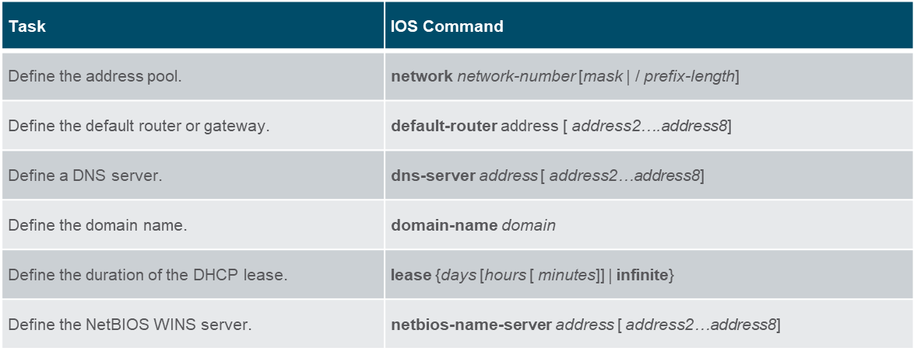
Steps to Configure a CISCO IOS DHCP Server
Step 3. Configure the DHCPv4 pool. The address pool and default gateway router must be configured.
Use the network statement to define the range of available addresses.
Use the default-router command to define the default gateway router.
Other optional commands are shown in the table.

Slide 15
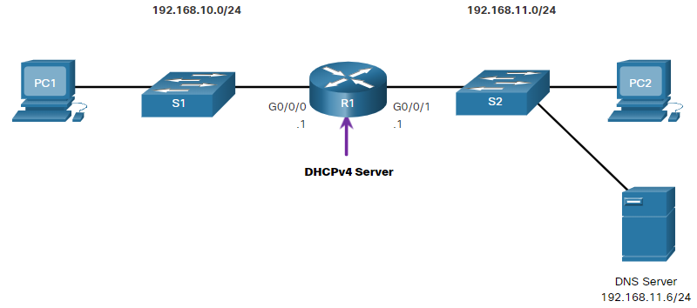
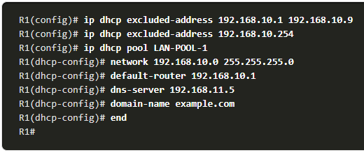
Example Configuration

Slide 16
DHCP Configuration Verification
Use the commands in the table to verify that the Cisco IOS DHCPv4 server is operational.
Command | Description
show running-config | section dhcp | Displays the DHCPv4 commands configured on the router.
show ip dhcp binding | Displays a list of all IPv4 address to MAC address bindings provided by the DHCPv4 service.
show ip dhcp server statistics | Displays count information regarding the number of DHCPv4 messages that have been sent and received

Slide 17
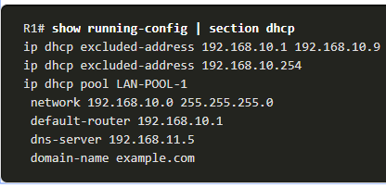
Verify DHCPv4 is Operational
Verify the DHCPv4 Configuration:
As shown in the example, the show running-config | section dhcp command output displays the DHCPv4 commands configured on R1. The | section [parameter] displays only the commands associated with DHCPv4 configuration.

Slide 18
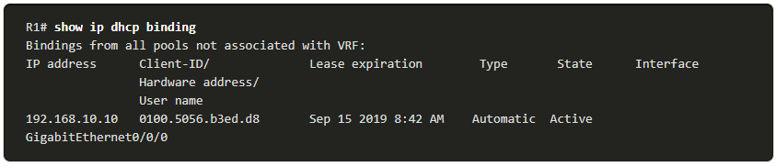
Verify DHCPv4 is Operational
Verify DHCPv4 Bindings:
As shown in the example, the operation of DHCPv4 can be verified using the show ip dhcp binding command. This command displays a list of all IPv4 address to MAC address bindings that have been provided by the DHCPv4 service.

Slide 19
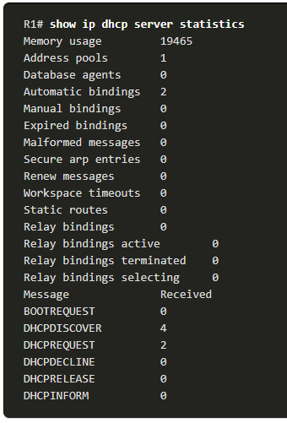
Verify DHCPv4 is Operational
Verify DHCPv4 Statistics:
The output of the show ip dhcp server statistics is used to verify that messages are being received or sent by the router. This command displays count information regarding the number of DHCPv4 messages that have been sent and received.

Slide 20
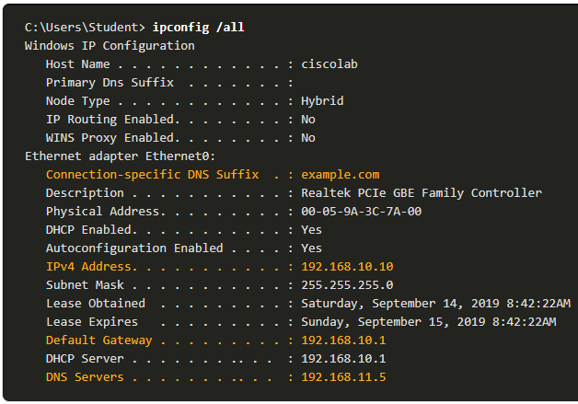
Verify DHCPv4 is Operational
Verify DHCPv4 Client Received IPv4 Addressing:
The ipconfig /all command, when issued on PC1, displays the TCP/IP parameters, as shown in the example. Because PC1 was connected to the network segment 192.168.10.0/24, it automatically received a DNS suffix, IPv4 address, subnet mask, default gateway, and DNS server address from that pool. No DHCP-specific router interface configuration is required. If a PC is connected to a network segment that has a DHCPv4 pool available, the PC can obtain an IPv4 address from the appropriate pool automatically.

Slide 21
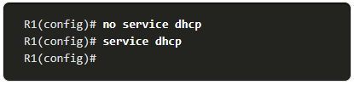
Disable the Cisco IOS DHCPv4 Server
The DHCPv4 service is enabled by default. To disable the service, use the no service dhcp global configuration mode command. Use the service dhcp global configuration mode command to re-enable the DHCPv4 server process, as shown in the example. Enabling the service has no effect if the parameters are not configured.
Note: Clearing the DHCP bindings or stopping and restarting the DHCP service may result in duplicate IP addresses being temporarily assigned on the network.

Slide 22
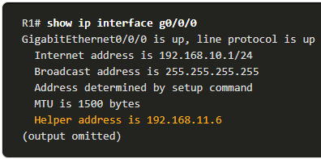
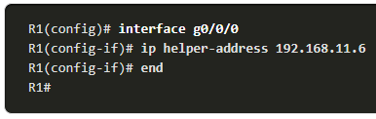
Configuring DHCP Relay
Configure R1 with the ip helper-address [address] interface configuration command. This will cause R1 to relay DHCPv4 broadcasts to the DHCPv4 server. As shown in the example, the interface on R1 receiving the broadcast from PC1 is configured to relay DHCPv4 address to the DHCPv4 server at 192.168.11.6.
When R1 has been configured as a DHCPv4 relay agent, it accepts broadcast requests for the DHCPv4 service and then forwards those requests as a unicast to the IPv4 address 192.168.11.6. The network administrator can use the show ip interface command to verify the configuration.

Slide 23
DHCPv4 Client Configuration

Slide 24
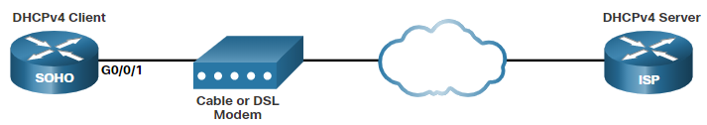
DHCP Operations
There are scenarios where you might have access to a DHCP server through your ISP. In these instances, you can configure a Cisco IOS router as a DHCPv4 client.
Sometimes, Cisco routers in a small office or home office (SOHO) and branch sites have to be configured as DHCPv4 clients in a similar manner to client computers. The method used depends on the ISP. However, in its simplest configuration, the Ethernet interface is used to connect to a cable or DSL modem.
To configure an Ethernet interface as a DHCP client, use the ip address dhcp interface configuration mode command.
In the figure, assume that an ISP has been configured to provide select customers with IP addresses from the 209.165.201.0/27 network range after the G0/0/1 interface is configured with the ip address dhcp command.

Slide 25
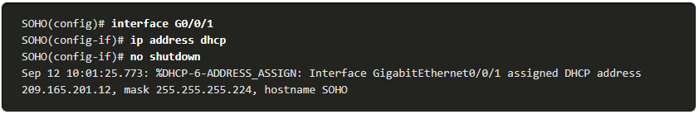
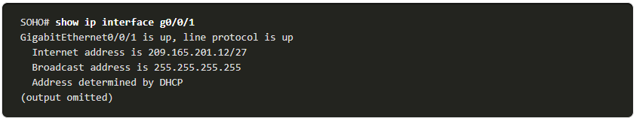
Example Configuration
To configure an Ethernet interface as a DHCP client, use the ip address dhcp interface configuration mode command, as shown in the example. This configuration assumes that the ISP has been configured to provide select customers with IPv4 addressing information.
The show ip interface g0/1 command confirms that the interface is up and that the address was allocated by a DHCPv4 server.

Slide 26
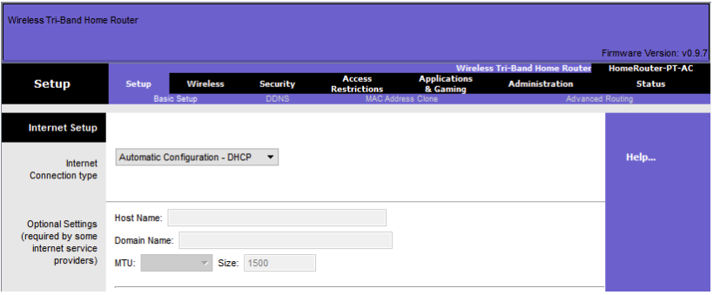
Home Router DHCPv4 Client
Home routers are typically already set to receive IPv4 addressing information automatically from the ISP. This is so that customers can easily set up the router and connect to the internet.
For example, the figure shows the default WAN setup page for a Packet Tracer wireless router. Notice that the internet connection type is set to Automatic Configuration - DHCP. This selection is used when the router is connected to a DSL or cable modem and acts as a DHCPv4 client, requesting an IPv4 address from the ISP.
Various manufacturers of home routers will have a similar setup.

Slide 27
DHCPv4 & NAT
Lecture 11 | Part 3 | CSE490 – WAN Routing
Department of Computer Science and Engineering School of Data & Science

Slide 28
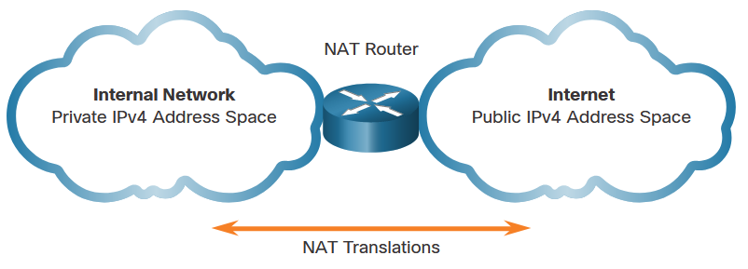
NAT

Slide 29
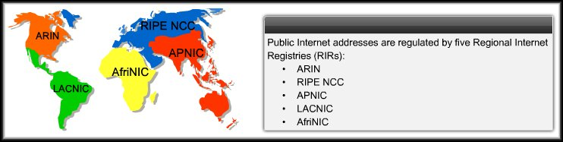
Scaling Networks with NAT
Reuse IP addresses by using NAT by creating two types of addresses: Private and Public Addressing.
All public Internet addresses must be registered with a Regional Internet Registry (RIR).
Organizations can lease public addresses from an ISP.
Then, they can use the private addresses in their internal networks
Only the registered holder of a public Internet address can assign that address to a network device.

Slide 30
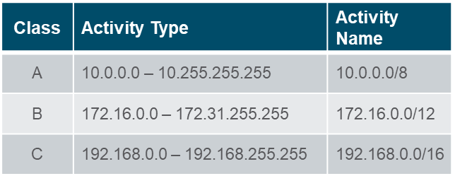
Category of Addresses
Private Internet Addresses:
These are reserved private Internet addresses drawn from three blocks (A, B and C)
These addresses are for private, internal network use only.
RFC 1918 specifies that private addresses are not to be routed over the Internet.
Two Issues:
You cannot route private addresses over the Internet.
There are not enough public addresses to allow organizations to provide one to every one of their hosts.
Public Internet Addresses
These are for public routing
Can be advertised globally.

Slide 31
What is NAT?
Networks need a mechanism to translate private addresses to public addresses at the edge of their network that works in both directions.
NAT-enabled routers retain one or many valid Internet IP addresses outside of the network and uses DHCP to provide private IPs to the users of the network
When the client sends packets out of the network, NAT translates the internal IP address of the client to an external address.
To outside users, all traffic coming to and going from the network has the same IP address or is from the same pool of addresses.
NAT
Private Address
Public Address

Slide 32
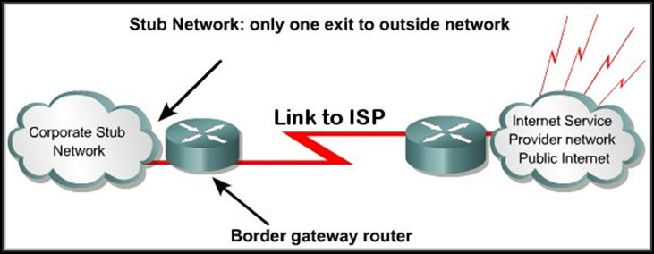
How NAT Works
A NAT enabled device typically operates at the border of a stub network.
When a host on the inside (private) network wants to access a host on the outside (public) network, the packet is sent to the border gateway router.
Inside Network: Usually an organization’s LAN
Outside Network: usually the Internet but it can be any network
The border gateway router performs the NAT process, translating the inside private address to an outside public address using an internal translation table.
The contents of the table will vary depending on the type of network translation being implemented.
Inside Private
Outside Public

Slide 33
NAT Terminology
NAT terminology is always applied from the perspective of the device with the translated address:
Inside address - The address of the device which is being translated by NAT.
Outside address - The address of the destination device.
Local address - A local address appears on the inside portion of the network.
Global address - A global address appears on the outside portion of the network.

Slide 34
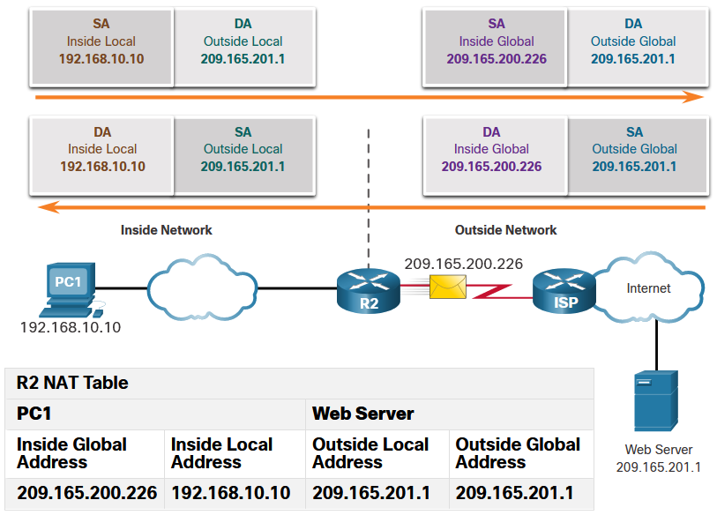
Types of Addresses
Inside local address
The address of the source as seen from inside the network. This is typically a private IPv4 address. The inside local address of PC1 is 192.168.10.10.
Inside global addresses
The address of source as seen from the outside network. The inside global address of PC1 is 209.165.200.226
Outside global address
The address of the destination as seen from the outside network. The outside global address of the web server is 209.165.201.1
Outside local address
The address of the destination as seen from the inside network. PC1 sends traffic to the web server at the IPv4 address 209.165.201.1. While uncommon, this address could be different than the globally routable address of the destination.

Slide 35
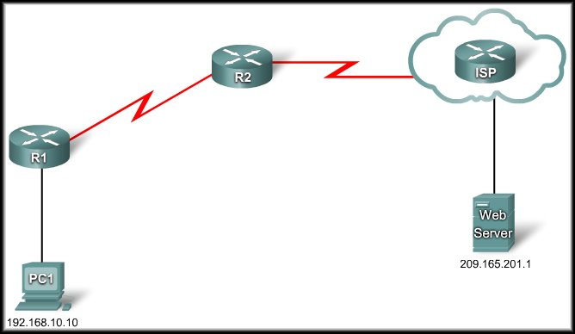
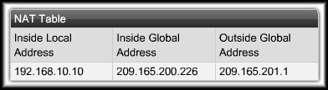
Example: NAT; Sending
R2: I have a packet for the outside network. I must translate the IP address.
209.165.200.226
DA | SA
209.165.201.1 | 209.165.200.226
DA | SA
209.165.201.1 | 192.168.10.10

Slide 36
Example: NAT; Receiving
R2: I have a packet for the inside network. I must translate the IP address.
DA | SA
192.168.10.10 | 209.165.201.1
209.165.200.226
DA | SA
209.165.200.226 | 209.165.201.1

Slide 37
Advantages of NAT
NAT provides many benefits:
NAT conserves the legally registered addressing scheme by allowing the privatization of intranets.
NAT conserves addresses through application port-level multiplexing.
NAT increases the flexibility of connections to the public network.
NAT provides consistency for internal network addressing schemes.
NAT allows the existing private IPv4 address scheme to remain while allowing for easy change to a new public addressing scheme.
NAT hides the IPv4 addresses of users and other devices.

Slide 38
Disadvantages of NAT
NAT does have drawbacks:
NAT increases forwarding delays.
End-to-end addressing is lost.
End-to-end IPv4 traceability is lost.
NAT complicates the use of tunneling protocols, such as IPsec.
Services that require the initiation of TCP connections from the outside network, or stateless protocols, such as those using UDP, can be disrupted.

Slide 39
DHCPv4 & NAT
Lecture 11 | Part 4 | CSE490 – WAN Routing
Department of Computer Science and Engineering School of Data & Science

Slide 40
PAT (NAT Overload)

Slide 41
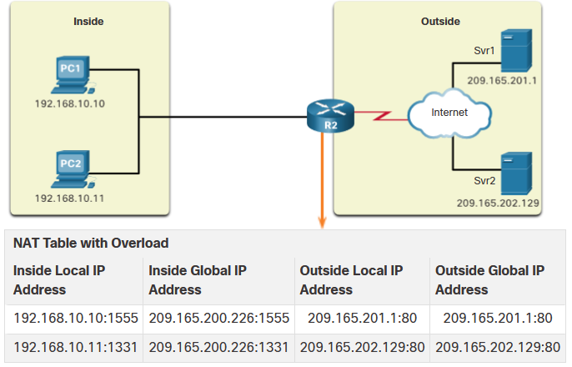
PAT
Port Address Translation (PAT), also known as NAT overload, maps multiple private IPv4 addresses to a single public IPv4 address or a few addresses.
With PAT, when the NAT router receives a packet from the client, it uses the source port number to uniquely identify the specific NAT translation.
PAT ensures that devices use a different TCP port number for each session with a server on the internet.

Slide 42
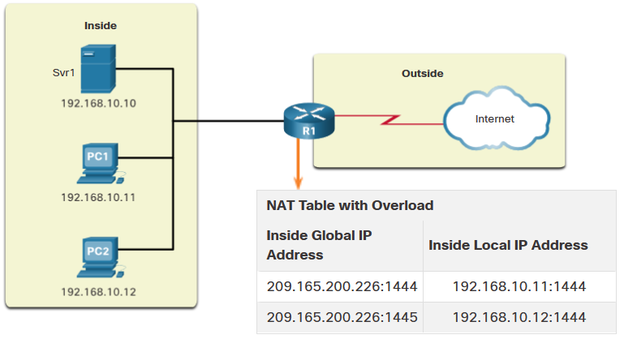
Next Available Port
PAT attempts to preserve the original source port. If the original source port is already used, PAT assigns the first available port number starting from the beginning of the appropriate port group 0-511, 512-1,023, or 1,024-65,535.
When there are no more ports available and there is more than one external address in the address pool, PAT moves to the next address to try to allocate the original source port.
The process continues until there are no more available ports or external IPv4 addresses in the address pool.

Slide 43
Packets without Layer 4 Segments
Some packets do not contain a Layer 4 port number, such as ICMPv4 messages. Each of these types of protocols is handled differently by PAT.
For example, ICMPv4 query messages, echo requests, and echo replies include a Query ID. ICMPv4 uses the Query ID to identify an echo request with its corresponding echo reply.
Note: Other ICMPv4 messages do not use the Query ID. These messages and other protocols that do not use TCP or UDP port numbers vary and are beyond the scope of this curriculum.

Slide 44
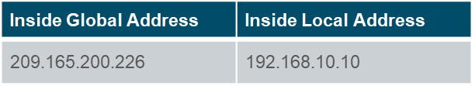
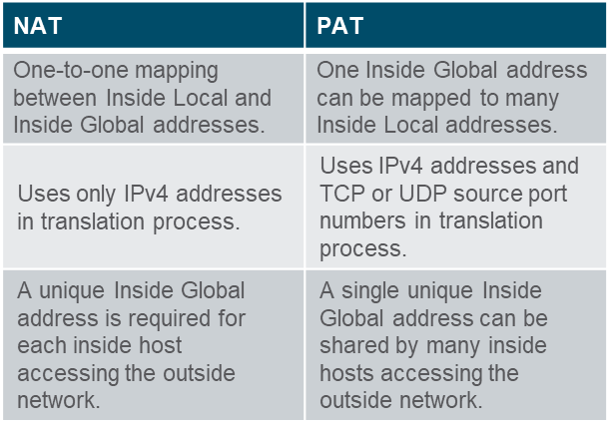
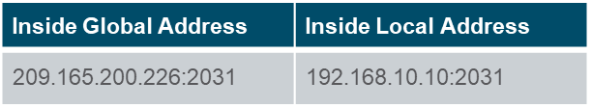
NAT vs PAT
NAT - Only modifies the IPv4 addresses
PAT - PAT modifies both the IPv4 address and the port number.

Slide 45
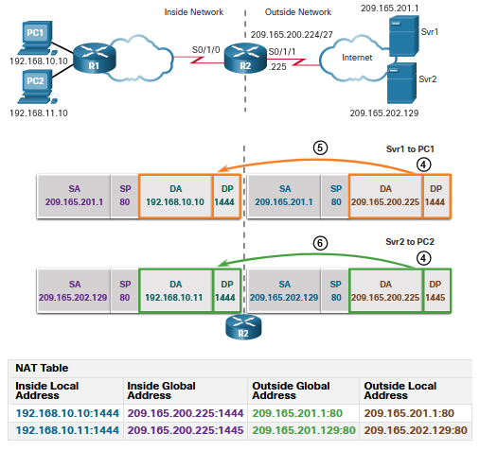
Example: PAT; Server to PC
PC1 and PC2 send packets to Svr1 and Svr2.
The packet from PC1 reaches R2 first. R2 modifies the source IPv4 address to 209.165.200.225 (inside global address). The packet is then forwarded towards Svr1.
The packet from PC2 arrives at R2. PAT changes the source IPv4 address of PC2 to the inside global address 209.165.200.225. PC2 has the same source port number as the translation for PC1. PAT increments the source port number until it is a unique value in its table. In this instance, 1445.

Slide 46
Example: PAT; PC to Server
PC1 and PC2 send packets to Svr1 and Svr2.
The packet from PC1 reaches R2 first. R2 modifies the source IPv4 address to 209.165.200.225 (inside global address). The packet is then forwarded towards Svr1.
The packet from PC2 arrives at R2. PAT changes the source IPv4 address of PC2 to the inside global address 209.165.200.225. PC2 has the same source port number as the translation for PC1. PAT increments the source port number until it is a unique value in its table. In this instance, it is 1445.

Slide 47
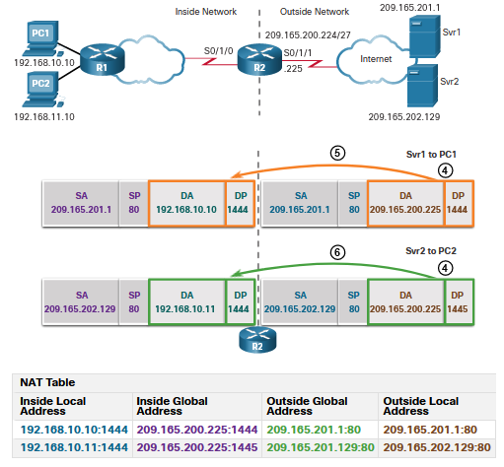
Example: PAT; Server to PC
The servers use the source port from the received packet as the destination port, and the source address as the destination address for the return traffic.
R2 changes the destination IPv4 address of the packet from Srv1 from 209.165.200.225 to 192.168.10.10, and forwards the packet toward PC1.
R2 changes the destination address of packet from Srv2. from 209.165.200.225 to 192.168.10.11. and modifies the destinations port back to its original value of 1444. The packet is then forwarded toward PC2.

Slide 48
Port Forwarding

Slide 49
Port Forwarding
Port forwarding on your router allows you to enter a port number (or possibly a range or combination of numbers, depending on the router), and an IP address.
All incoming connections with a matching port number will be forwarded to the internal computer with that address.
A packet sent to the public IP address and port of a router can be forwarded to a private IP address and port in inside network.
Port forwarding is helpful in situations where servers have private addresses, not reachable from the outside networks.

Slide 50
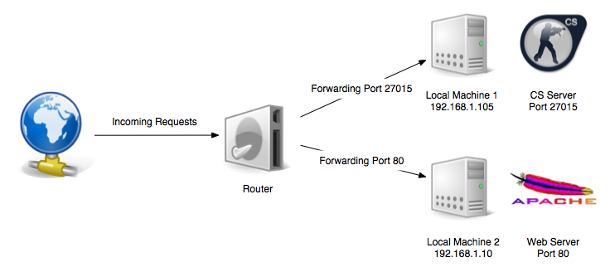
Example: Port Forwarding

Slide 51
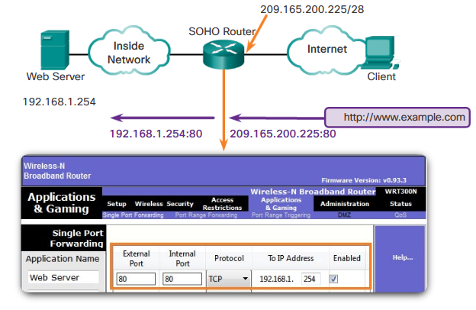
Example: Port Forwarding; SOHO

Slide 52
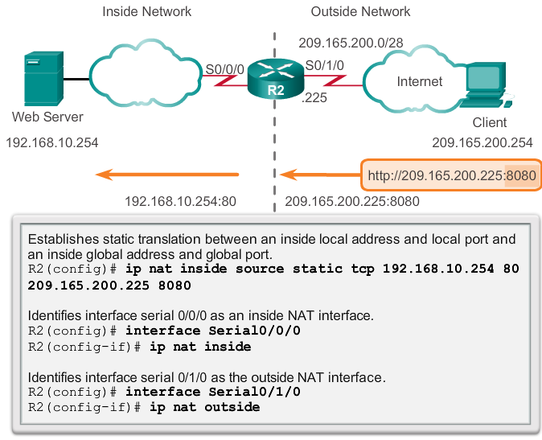
Configuring Port Forwarding
In IOS, Port forwarding is essentially a static NAT translation with a specified TCP or UDP port number.

Slide 53
The End

